Slide 1
Machine Learning in Automated Text Categorization By: Fabrizio Sebastiani
Yuha Yi Stats 517

Slide 2
Introduction
Application in technology based era
Information Retrieval
Forecasting Businesses
Sentiment Analysis

Slide 3
Text Classification
Building text classifiers, i.e. software systems that classify documents into pre-defined categories (classes or labels)
News paper has pre-defined categories
Weather, Crime, Sports
Notes:
In text classification, it is assumed that a ground truth exists such that it specifies how a document should be classified. However, because it isn’t known how it should be classified, text classification consists in building a method that approximates this classification.

Slide 4
Text Classification
Assumption of Ground Truth that specifies how documents should be classified
We know it exists, but how should it classify?
TC Approximation

Slide 5
Single-Label & Multi-Label
Single-Label
One category to each document
More general and most common in TC
Multi-Label
Any number of categories can be assigned to each document.

Slide 6
Category and Document pivoted Classification
Document Pivoted Classification – DPC (Most Common)
Given a document in a set of Documents, find all categories in set C under which it should be filled
Category Pivoted Classification – CPC
Given a category in a set of Categories, find all documents that should be filed under it
DPC when documents are available one at a time
Email filtering
CPC when new categories may be added after documents have already been classified
Patent classification

Slide 7
Indexing and Information Retrieval
Document Filtering – Delivering proper documents to correct audience
Sports magazine (boolean example)
Email filtering
Key words
Sentiment Analysis
Customer review – Multi labeled
Positive or Negative Review
Question, inquiry, or other

Slide 8
Error
Word Sense Disambiguation
Going to the fair
That was not fair
Bag of words

Slide 9
Solution
Pre-processing
Removing stop words (topic neutral)
Stemming
Fishing, fisher, fished
Fish
Lemmatization

Slide 10
Indexing and Information Retrieval
Full text indexing
Partial text indexing
Metadata
Bag of Words method
Frequency
N-grams
Inverse document frequency factor
Automatic identification of genre
Language identification

Slide 11
Machine Learning
Train Test set
Labelled corpus
A set of documents previous classified
Glimpse of the ground truth
Alternative approach, K-fold cross validation
Common when training corpus is small
Corpus partitioned into sets

Slide 12
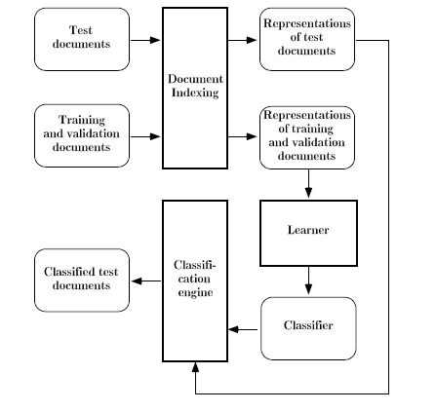
The Process

Slide 13
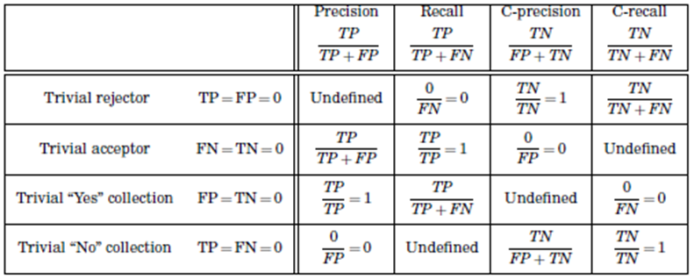
Text Categorization Effectiveness

Slide 14
